Slide 1
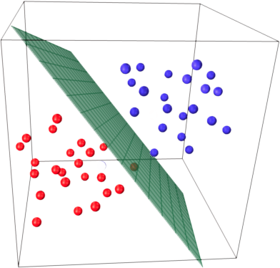
Data Science Camp
Logistic Regression

Slide 2

This Lesson
Logistic Regression
Regularization in Logistic Regression
Cat/Non-Cat image Classification
Logistic Regression in sklearn

Slide 3

Samples Of Classification Tasks
Spam filtering (spam/no spam)
Sentiment Analysis ( positive/negative)
Tumor Classification (malignant/benign)
Medical Diagnosis (Healthy/Cold/Flu/Pneumonia)
Topic Classification (Education/Finance/Technology/etc.)
Image Classification
...
Notes:
Mention about 1/0 - positive negative - binary
Mention about multi labels

Slide 4
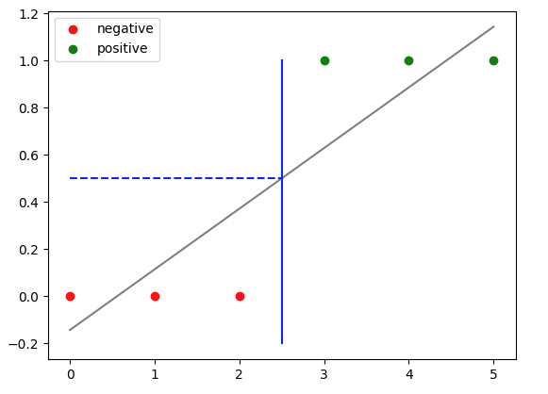
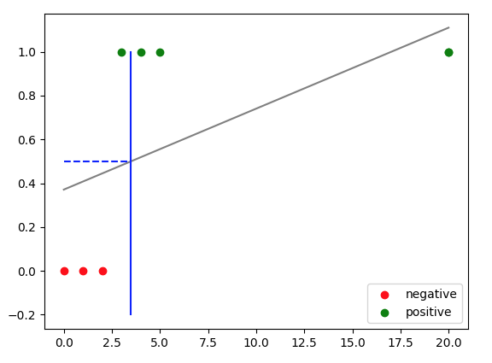
Linear regression for classification
Does not work well for any X
Hypothesis values may be far smaller than 0 or larger than 1

Slide 5

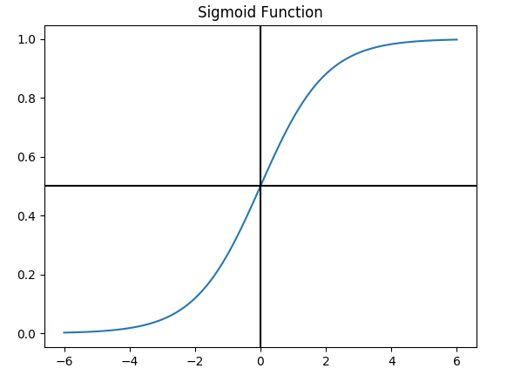
Logistic (Sigmoid) Function
In python:
import numpy as np
def sigmoid(x):
return 1 / (1 + np.exp(-x))
sigmoid(6)
Or
from scipy.stats import logistic
logistic.cdf(6)
# Cumulative distribution function

Slide 6




Hypothesis For Logistic Regression

Slide 7


Interpretation Of Hypothesis Value

Slide 8

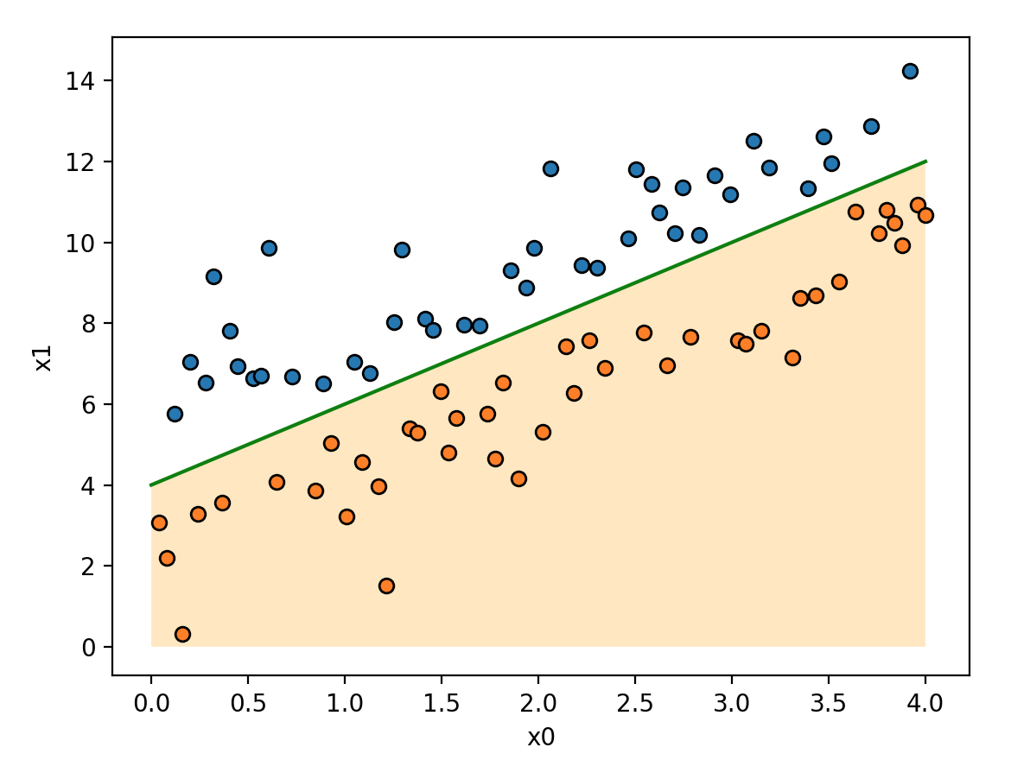
Visualization of Hypothesis
Decision boundary:

Slide 9



Cost Function For Logistic Regression
For linear regression:
For linear regression:

Slide 10

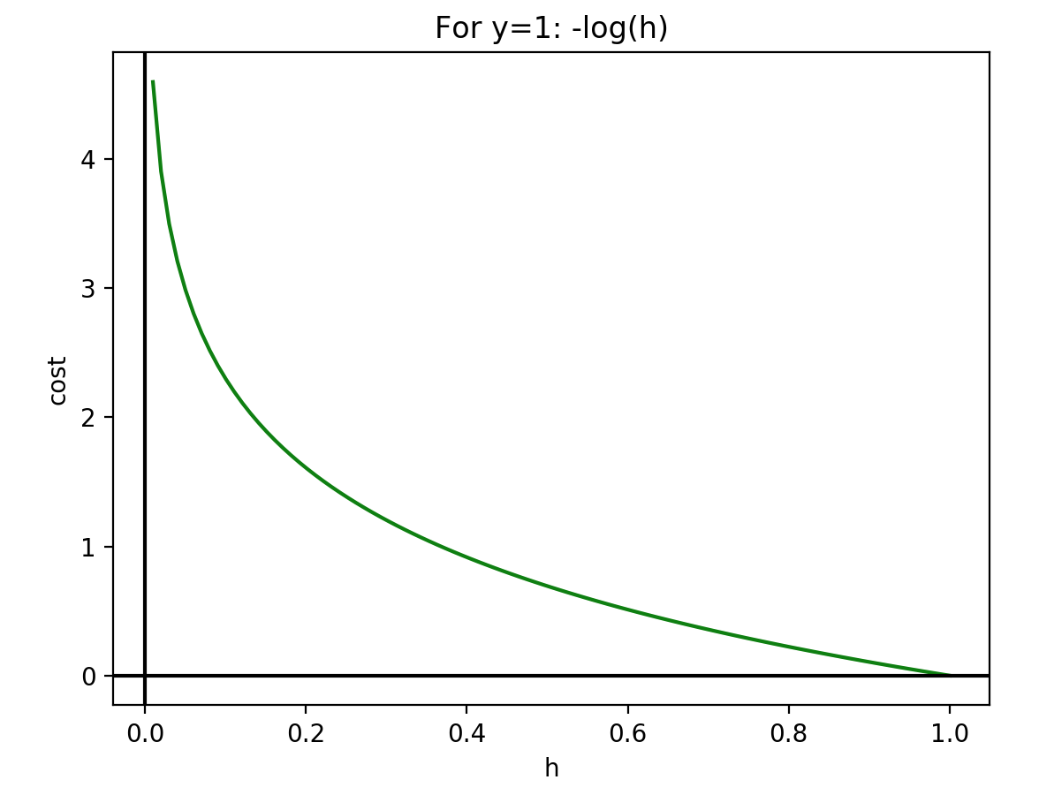
Visualization Of Cost Penalties

Slide 11

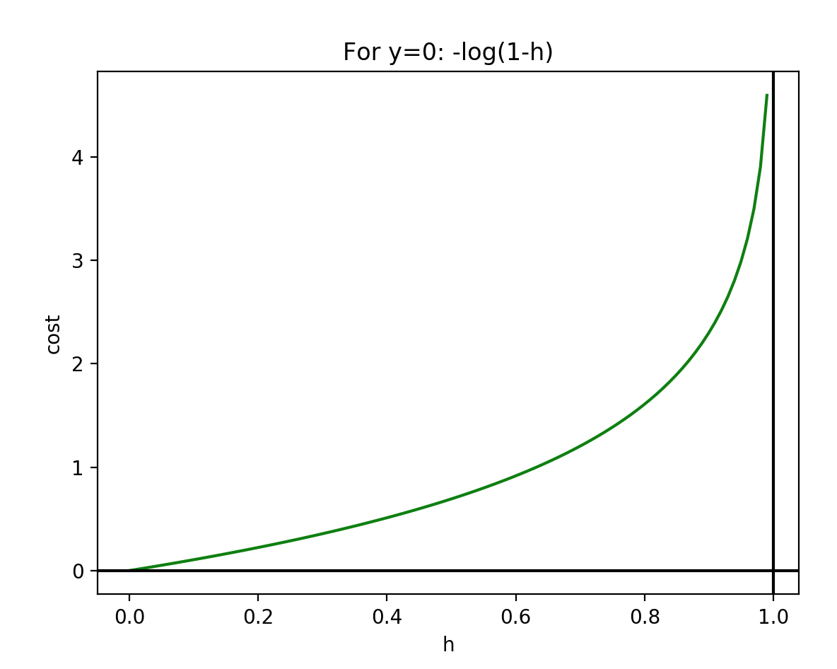
Visualization Of Cost Penalties

Slide 12

Let’s rewrite h in the following way
(consistent with further Neural Networks):
Logistic Regression As 1-Step Neural Network

Slide 13



Derivatives 1

Slide 14

Derivatives 2

Slide 15


Derivatives 3

Slide 16


Derivatives 4
Notes:
D a по dz в другому множнику

Slide 17



Matrix Implementation Of Derivative Calculation

Slide 18


Matrix Implementation Of Derivative Calculation

Slide 19
Sklearn Implementation
In:
from sklearn.linear_model import LogisticRegression
y_train = np.squeeze(Y_train) # LogisticRegression requires 1d input for y
clf = LogisticRegression().fit(X_train_scaled, y_train)
print("train accuracy= {:.3%}".format(clf.score (X_train_scaled, y_train)))
y_test = np.squeeze(Y_test)
print("test accuracy= {:.3%}".format(clf.score (X_test_scaled, y_test)))
print('y_predicted = {}. ' . format(np.squeeze(clf.predict(my_image)))
Out:
train accuracy= 100.000%
test accuracy= 72.000%
y_predicted = 0.

Slide 20

Regularized Logistic Regression
Note: sklearn uses C parameter for regularization.
The less C the larger regularization

Slide 21
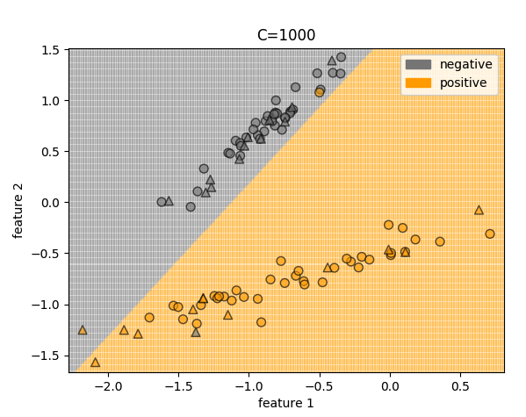
Visualization Of Logistic Regression

Slide 22
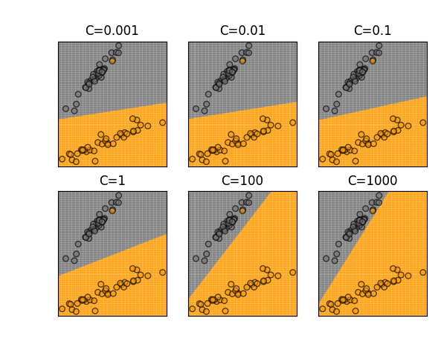
Visualization Of Regularization

Slide 23
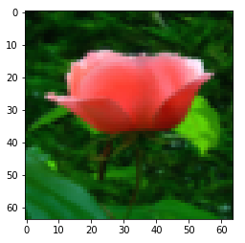
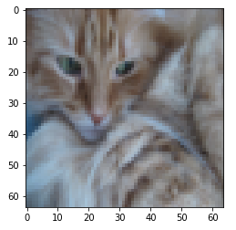
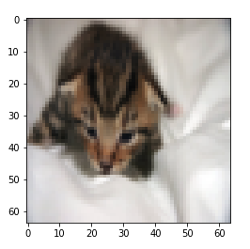
Cat vs Non-Cat Classifier

Slide 24

Home Task
Implement Logistic Regression
for Cat/Non-Cat classification
Use sklearn.datasets.load_breast_cancer
and apply sklearn.LogisticRegression

Slide 25
Visualization Of Linear Decision Boundary
Decision boundary:

Slide 26
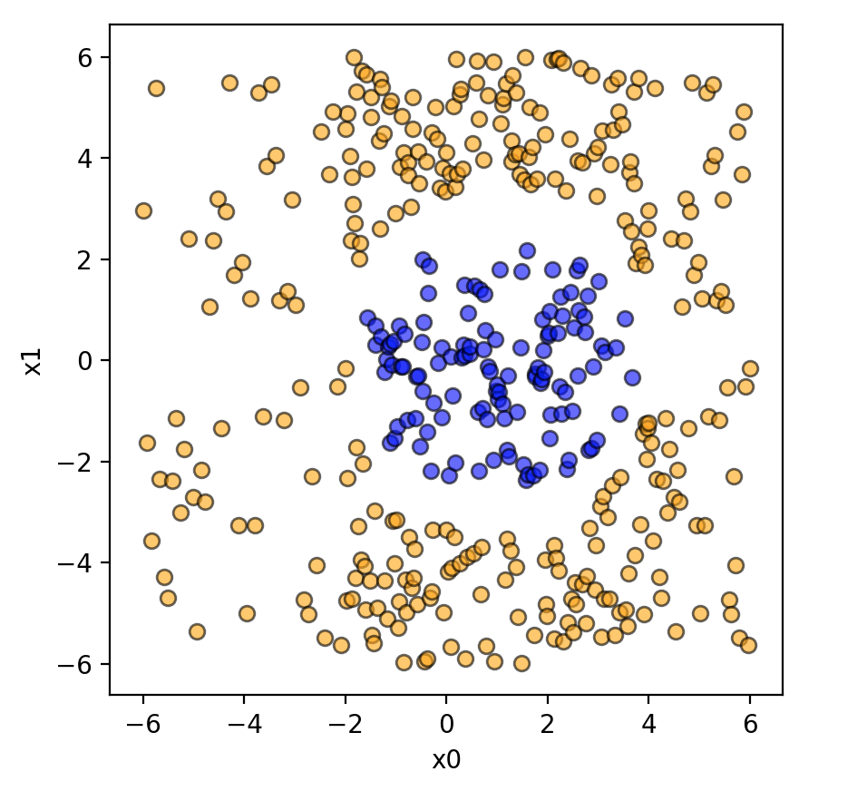
Non-linear Decision Boundary

Slide 27

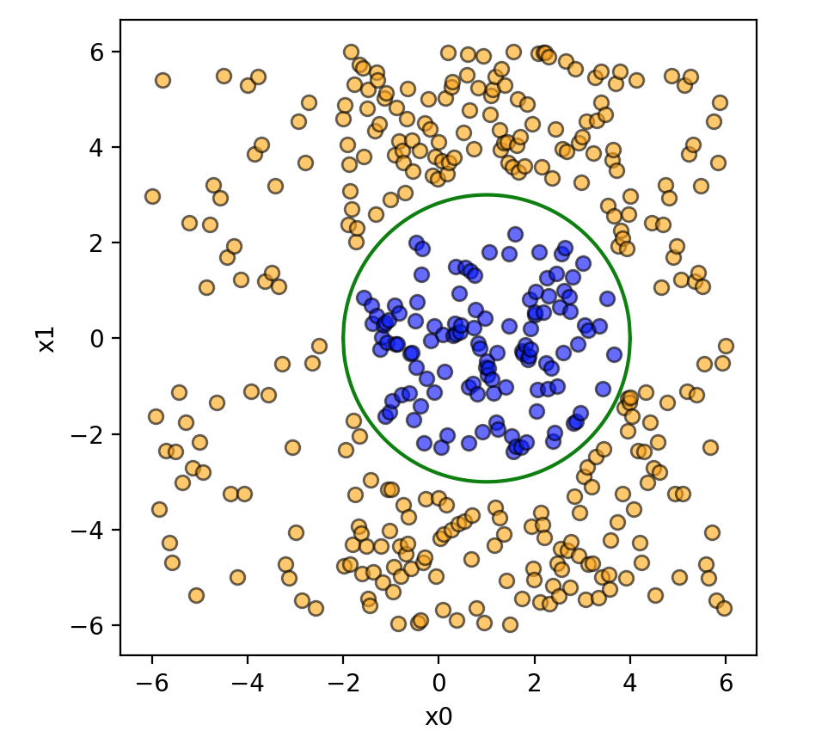
Multinomial Features For Logistic Regression

Slide 28
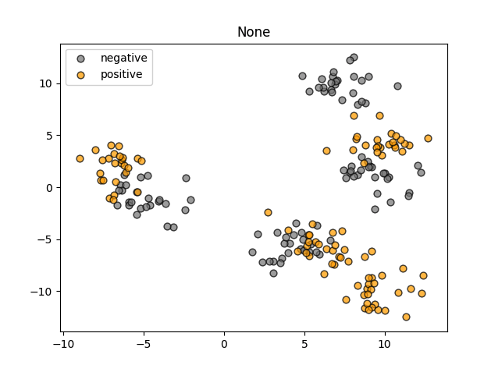
Make Blobs

Slide 29
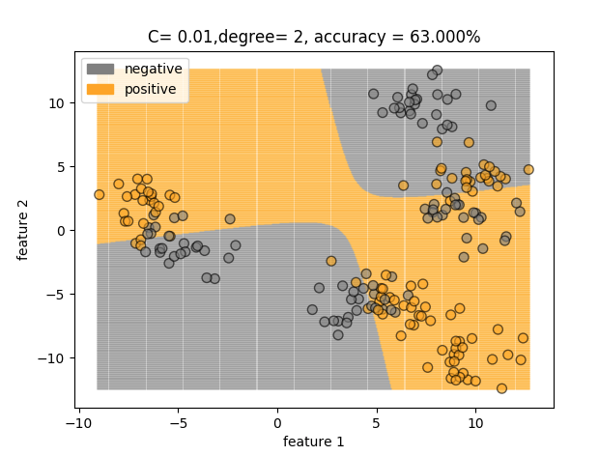
Polynomial Features degree= 2

Slide 30
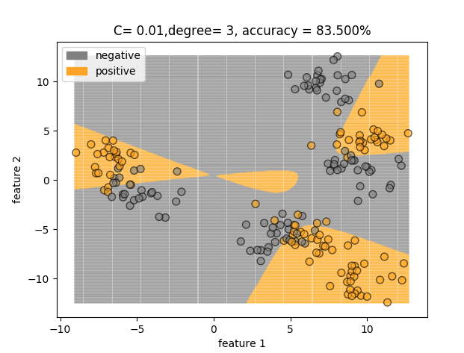
Polynomial Features degree= 3

Slide 31
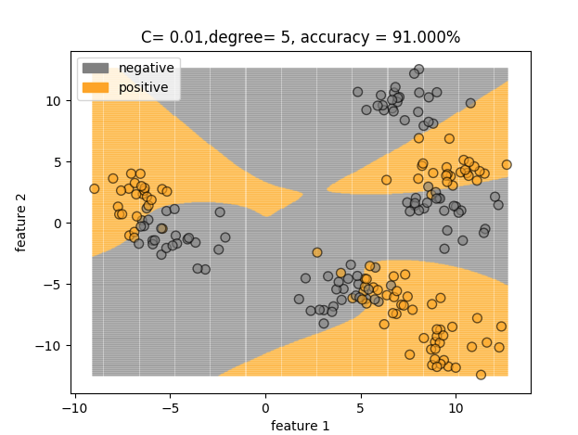
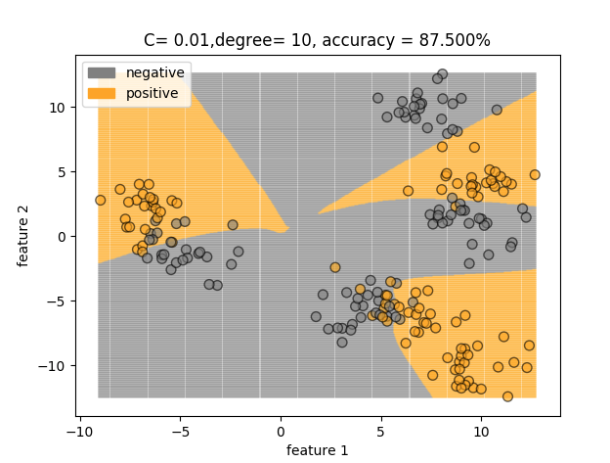
Polynomial Features higher degrees

Slide 32
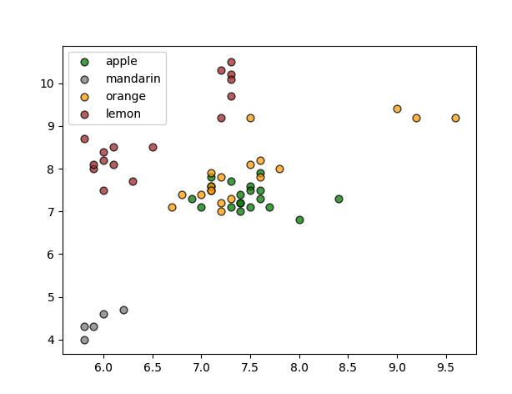
Multi Class Classification

Slide 33

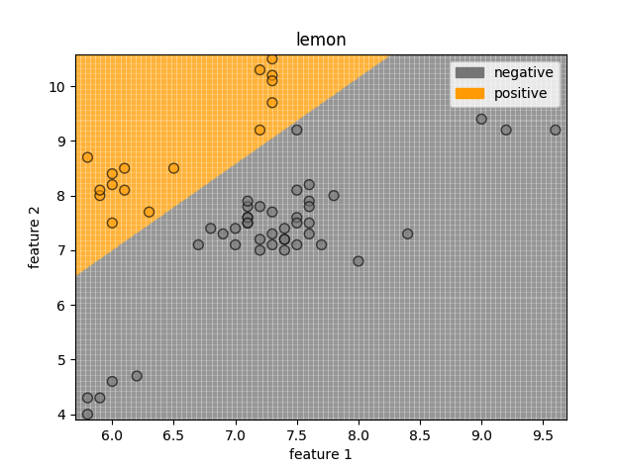
One vs Rest Classification
Notes:
The multiclass support is handled according to a one-vs-one scheme.
https://scikit-learn.org/stable/modules/generated/sklearn.svm.SVC.html
The difference is the number of classifiers you have to learn, which strongly correlates with the decision boundary they create.
Assume you have N different classes. One vs all will train one classifier per class in total N classifiers. For class i it will assume i-labels as positive and the rest as negative. This often leads to imbalanced datasets meaning generic SVM might not work, but still there are some workarounds.
In one vs one you have to train a separate classifier for each different pair of labels. This leads to N(N−1)/2 classifiers. This is much less sensitive to the problems of imbalanced datasets but is much more computationally expensive.
In sklearn :
*decision_function_shape* : ‘ovo’, ‘ovr’, default=‘ovr’
Whether to return a one-vs-rest (‘ovr’) decision function of shape (n_samples, n_classes) as all other classifiers,
or the original one-vs-one (‘ovo’) decision function of libsvm which has shape (n_samples, n_classes * (n_classes - 1)/2).
However, one-vs-one (‘ovo’) is always used as multi-class strategy. (edited)

Slide 34
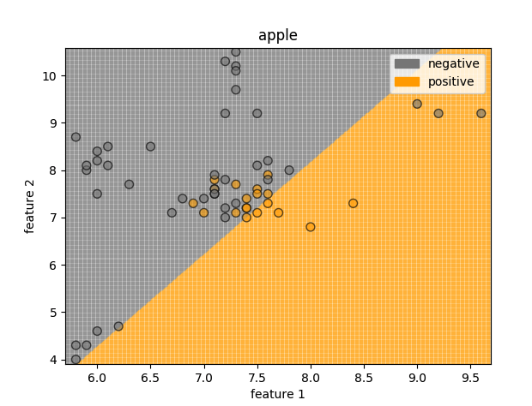
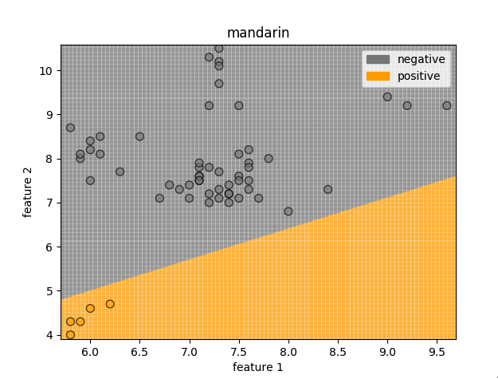
One vs Rest Classification

Slide 35
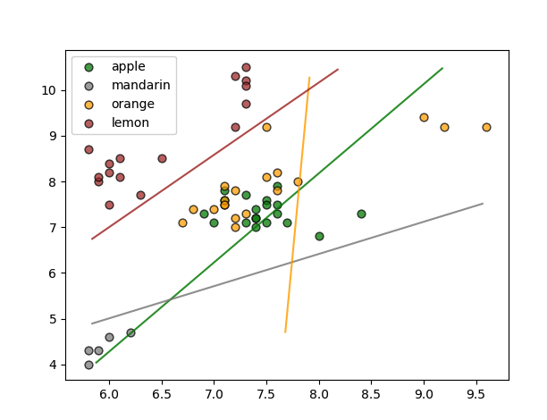
Sklearn Multiclass Logistic Regression
clf= LogisticRegression().fit(X, y)
clf.intercept_, clf.coef_
(array([-6.12485807, 8.10324695, -9.23278103, 21.65073969]),
array([[ 1.61099975, -0.82707511],
[ 7.21779484, -10.2644604 ],
[ 1.23341426, -0.0511218 ],
[-13.80744571, 8.74015042]]))

Slide 36
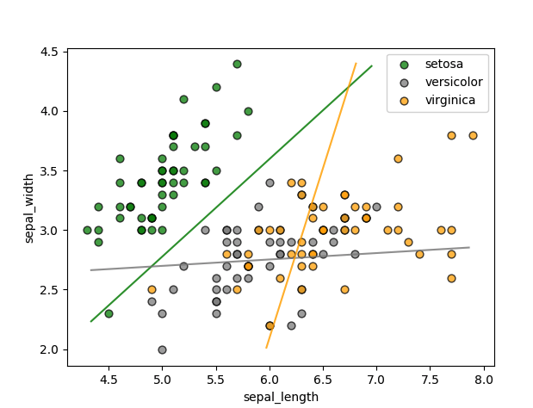
Iris Dataset Sklearn Classification

Slide 37

Next
Support Vector Machine
Spam /Non-Spam classification

Slide 38
Learn more
Neural Networks and Deep Learning
https://www.coursera.org/learn/neural-networks-deep-learning/
scipy.stats.logistic
https://docs.scipy.org/doc/scipy/reference/generated/scipy.stats.logistic.html#scipy.stats.logistic
sklearn.datasets.make_classification
https://scikit-learn.org/stable/modules/generated/sklearn.datasets.make_classification.html
Sklearn.datasets.load_breast_cancer
https://scikit-learn.org/stable/modules/generated/sklearn.datasets.load_breast_cancer.html
Machine Learning (free of charge)
https://www.coursera.org/learn/machine-learning/
Applied Machine Learning in Python
https://www.coursera.org/learn/python-machine-learning
Notes:
All home task text is provided in handouts

Slide 39

THANKS!
Any questions?

